Slide 1

How Atticus Has Used AI
and How We Hope It Will Be Used in the Future
© 2020 The Atticus Project

Slide 2
List of Slides (DO NOT DELETE)
(Slide 2) Terminology Review-Jing
NLP, Training Dataset, supervised/unsupervised (refer to Module 1)
(Slide 3-4) Atticus overview-Jing
What is Atticus working on?
Training Dataset
not product or code/AI model
How does Atticus do it?
Use eBrevia to annotate/label selected clauses [Link to Published Labels on Atticus Website)
Labeling inside peek - Screenshots from eBrevia
Science behind atticus
1. More documents, higher accuracy (Anya)
2. Should be a # of documents where it will guarantee a good f-score (0.80) (Andrew)
3. We can find out when AI reaches a consistent accuracy and reallocate human labelling (based on f-score) (Tagir)
We can look at multiple algorithms and find out which ones are generally easy or hard
Different algorithms will produce different results

Slide 3
Concept Review
Review what was covered in module 1
Format based on modules 2 and 3

Slide 4
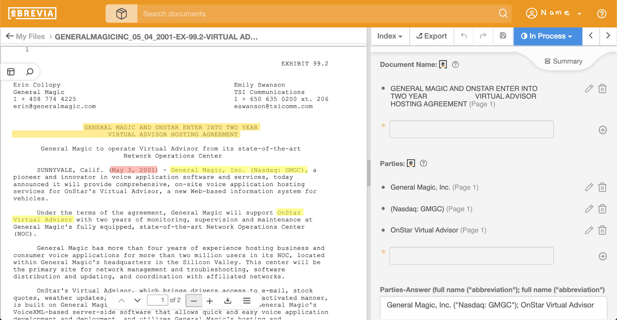
Atticus Overview
What is Atticus working on?
We are training a dataset, not making a product
How does Atticus do it?
We use eBrevia to annotate and label certain clauses
Here’s a sneak peek inside eBrevia!

Slide 5
Science Behind Atticus - Hypothesis 1
Hypothesis: More examples = higher f-score/accuracy

Slide 6
Hypothesis 1: More Examples = Higher Accuracy
Purpose:

Slide 7
Hypothesis 1: More Examples = Higher Accuracy
Background / Research:

Slide 8
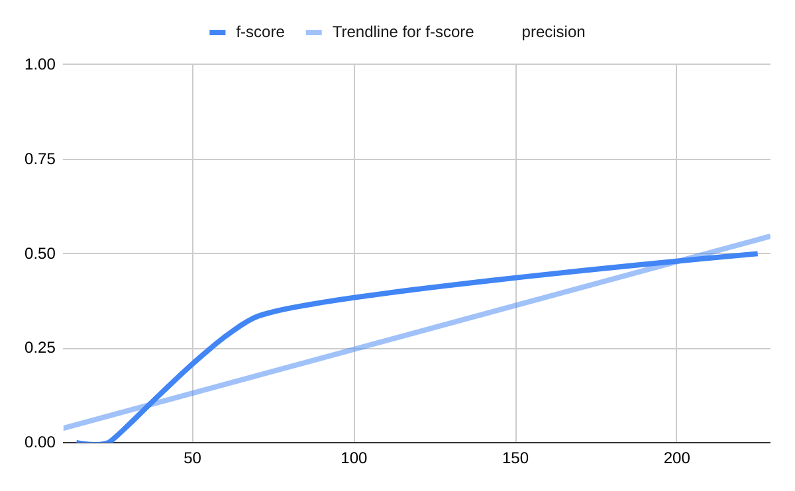
Hypothesis 1: More Examples = Higher Accuracy
Procedures:
Checked automatic trendline created by Google Sheets.
Differences that either I didn't notice, or ones with net difference equal to or less than .01, were considered "same".

Slide 9
Hypothesis 1: More Examples = Higher Accuracy
Data
Yes | Same | No
Anti-Assignment Audit Rights Exclusivity Insurance Irrevocable or Perpetual License Joint IP Ownership License Grant Minimum Commitment Most Favored Nation Notice Period Revenue Profit Sharing ROFR/ROFN/ROFN Signing Date Termination for Convenience Third Party Beneficiary Uncapped Liability Volume Restriction | Affiliate License - Licensee Affiliate License - Licensor Change of Control Covenant Not to Sue Effective Date Governing Law Post-Termination Covenants Price Increase Restrictions Renewal Term | IP Assignment No-Solicit of Customers No-Solicit of Employees Non-Compete Non-disparagement

Slide 10
Hypothesis 1: More Examples = Higher Accuracy
Results:
True for 17/31 of labels
Same for 9/31 of labels
False for 5/31 of labels
So, only true for an iffy 55% of labels

Slide 11
Hypothesis 1: More Examples = Higher Accuracy
Conclusion:
Only true for a bit more than half of them,
(looking into the no's rn)
Why is this useful/important/significant?
Things learned, learnings will be used for?

Slide 12
Science Behind Atticus - Hypothesis 2
Hypothesis 2: There is usually a range of number of examples where the best f-scores (hopefully 0.80+) can be reached.

Slide 13
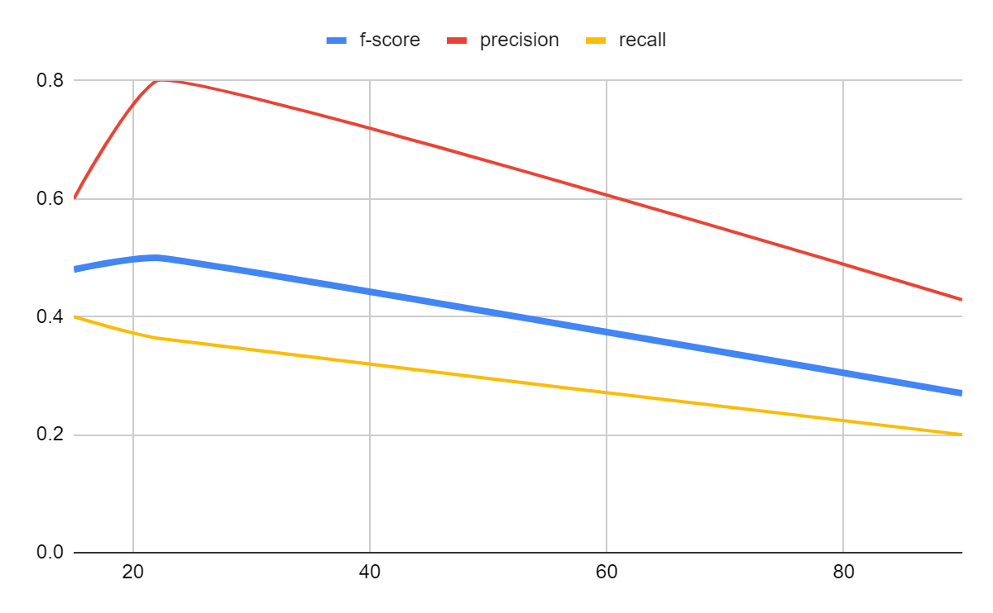
Background and Research
What we are trying to do in this experiment is to prove that the AI will behave similarly if we give it different models with similar numbers of examples
Some of the labels never reach a good f-score, but that doesn’t matter for this hypothesis.
This is taken from the label “Non-Compete”. The green circle marks the sweet spot, where the highest f-scores are seen. Even though they aren’t high, it doesn’t matter for this hypothesis.

Slide 14
Procedures
If two or more different models with similar number of examples (at most 10 examples apart) yield consistent results (at most 0.05 apart), the label goes into the “consistent” section
Only applies if both f-scores are among the highest. If they are, they are colored green. Otherwise, they are colored orange.
If all models have an f-score of 0 the label goes into the “unreliable data” section
Colored red
Otherwise, they go into the “tentative” section. The reason is that since there is always one model with the highest score, another future model with a similar number of examples can yield a similarly high score.
If a label had no two models that were less than 10 examples apart, it gets colored blue

Slide 15
Data
Consistent Labels (two models at most 10 examples apart have f-scores differ by less than 0.05) | Tentative Labels (no two models are at most 10 examples apart or their f-score differs by more than 0.05) | Unreliable Data (all models stay at f-score of 0)
Anti-Assignment Exclusivity Effective Date Joint IP Ownership Signing-Date Minimum Commitment Non-Compete Post-termination Covenants No-Solicit of Customers Revenue/Profit Sharing | Audit Rights Change of Control Insurance IP-Assignment Irrevocable or Perpetual License License Grant Most Favored Nation No-Solicit of Employees Non-Disparagement Notice Period to Terminate Auto-renewal Price Increase Restrictions Renewal Term Uncapped Liability Volume Restriction Governing Law ROFR/ROFN/ROFN Termination for Convenience Third Party Beneficiary | Affiliate License-Licensee Affiliate License-Licensor ("Magic Hat") Covenant Not to Sue

Slide 16
Results
Requirements met for 9 labels
7 colored green
2 colored orange
Requirements yet to be met for 20 labels
16 colored blue
4 colored red
AI consistently fails for 3 labels
Total: 32 labels

Slide 17
Conclusion
While most of the labels have yet to satisfy these conditions, we have located the “sweet spot” for some of these already.
When we test more and more, we will probably find more of these “sweet spots”.

Slide 18
Science Behind Atticus - Hypothesis 3
We can find out when AI reaches a consistent accuracy and reallocate human labelling (based on f-score)

Slide 19
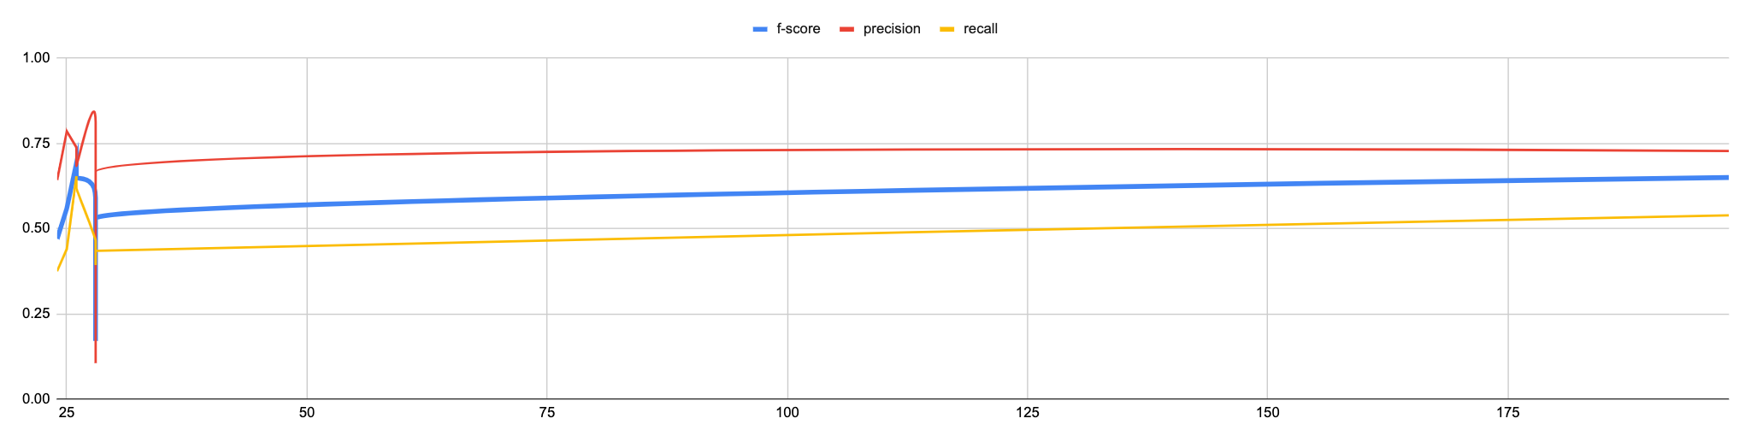
Background / Research
Based on Hypothesis one, if there are more examples, most of the labels will have a higher F-Score.
Some labels have enough examples, that the F-Score will stabilize, and change more slowly if you keep adding more contract examples.
As shown in the chart below, the more examples you have for signing date, the more the F-Score Increases, however, it becomes more consistent and stagnant.

Slide 20
Procedures
If Label has an f-score higher than 0.6 and is consistent, it will go in the consistent label section.
If Label is either significantly changing in f-score and has at least 3 models with at least 40 examples in the last model, it is in the inconsistent label section.
If Label has either less than 3 models, less than 40 examples on the last model, or is consistent at a low score (lower than 0.6 f-score), it will go in the Not Enough Models and Examples section.
Not Enough Models and Examples Color Code for Labels:
Green = Not Enough Models (but enough Examples). Purple = Red and Blue.
Blue = Not Enough Examples and/or Models.
Red = Inconsistent at a low F-Score.

Slide 21
Data
Consistent Labels (where more examples will not make much difference) | Inconsistent Labels (more examples will make a significant difference) | Not Enough Models and Examples to Know or consistent at a low f-score
Anti-Assignment Effective Date Governing Law Signing-Date | Change of Control Exclusivity Non-Compete Notice Period to Terminate Auto-renewal Renewal Term Revenue/Profit Sharing | Uncapped Liability Volume Restriction Affiliate License-Licensee Affiliate License-Licensor ("Magic Hat") Covenant Not to Sue Insurance IP-Assignment Joint IP Ownership Minimum Commitment Most Favored Nation No-Solicit of Customers No-Solicit of Employees Post-termination Covenants Price Increase Restrictions ROFR/ROFN/ROFN Third Party Beneficiary Audit Rights Irrevocable or Perpetual License License Grant Non-Disparagement Termination for Convenience

Slide 22
Results
4 Consistent Labels
7 Inconsistent Labels
21 Not Enough Examples/Not Enough Models/ Consistent low F-Score.
32 Labels Total
Colored Labels
6 Green Labels
3 Blue Labels
3 Red Labels
9 Purple Labels

Slide 23
Conclusion
There are a lot of Labels that need more examples and/or models, it is best to focus human time on those.
Also, there were labels that were consistent at low F-Scores which is most likely due to the NLP system itself. It is better to not focus on those since it is a problem with eBrevia rather than the dataset itself.

Slide 24
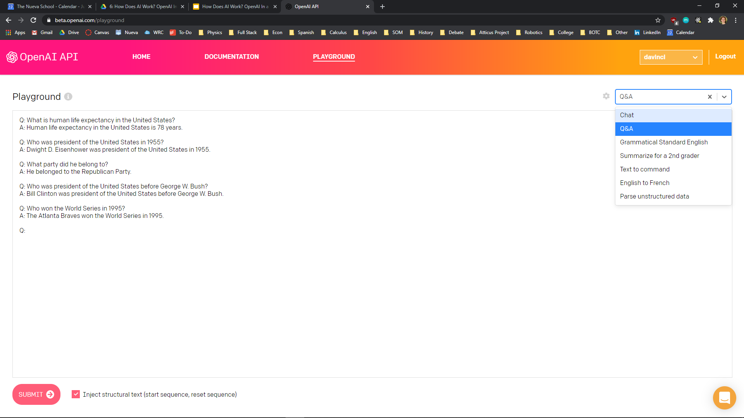
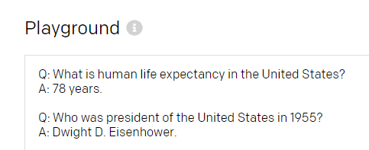
Ease of Use: Playground
GPT-3, currently in beta, is available through an online playground with presets such as a chatbot, Q&A, and “summarize for a 2nd grader.”
In addition, users can give the AI example question and answer pairs to teach it the structure they want the output to look like. The model can learn from just one or two examples.
Sample structure provided by user
Subsequent output matches the structure

Slide 25
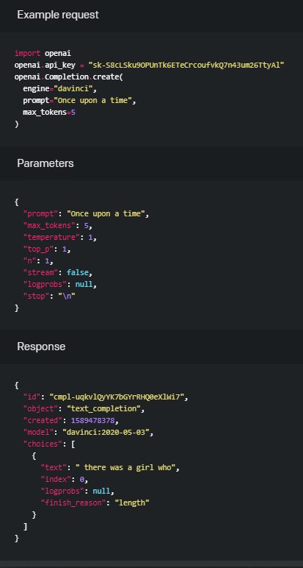
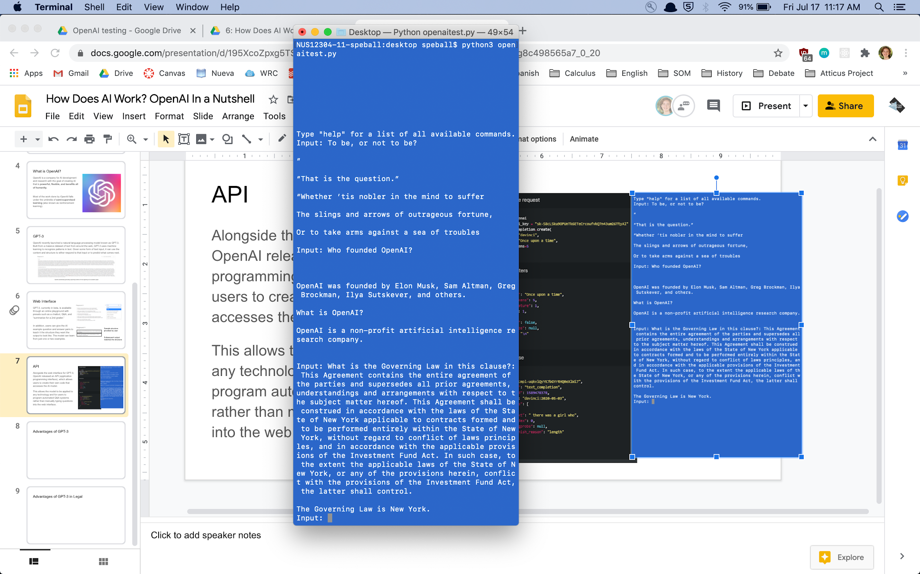
Ease of Use: API
Alongside the web interface for GPT-3, OpenAI released an API (application programming interface), which allows users to create their own code that accesses the AI model.
This allows the model to be applied to any technology and for users to program automated Q&A systems rather than manually typing questions into the web interface.

